Slide 1
Time Series Prediction using RNN

Slide 2
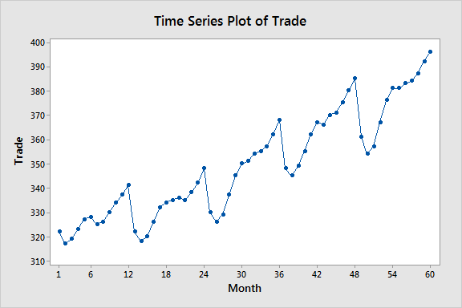
Time Series Prediction
Time series prediction, or time series forecasting, is a branch of data analysis and predictive modeling that aims to make predictions about future values based on historical data points in chronological order.
In a time series, data is collected and recorded over regular intervals of time (i.e. hourly, daily, monthly, or yearly). Examples of time series data include stock prices, weather measurements, sales figures, website traffic, and more
The fields of application of Time series Analysis are numerous: Demand Planning is one of the most common application, however, from industry to industry there are other possible uses. For instance:
Forecasting of shipped packages: workforce planning
Forecasting of sales during promotions: optimizing warehouses
Claims prediction: determining insurance policies
Predictive Maintenance: improving operational efficiency
Energy load forecasting: better planning and trading strategies

Slide 3
Recurrent Neural Networks (RNNs)
Recurrent Neural Networks (RNNs) offer several advantages for time series prediction tasks.
They can handle sequential data of varying lengths, capturing long-term dependencies and temporal patterns effectively. RNNs accommodate irregularly spaced time intervals and adapt to different forecasting tasks with input and output sequences of varying lengths.
The vanishing gradient problem is a challenge that affects the training of deep neural networks, including Recurrent Neural Networks (RNNs).
It occurs when gradients, which indicate the direction and magnitude of updates to network weights during training, become very small as they propagate backward through layers. This phenomenon hinders the ability of RNNs to learn long-range dependencies and can lead to slow or ineffective training.
While techniques like LSTMs and GRUs mitigate some issues, other advanced architectures like Transformers might outperform RNNs in certain complex time series scenarios, necessitating careful model selection.

Slide 4
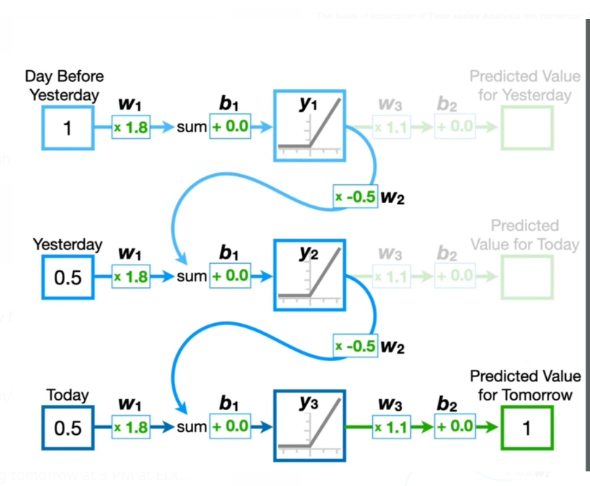

Slide 5
Long Short-Term Memory (LSTM) and Gated Recurrent Unit (GRU)
1)Traditional RNNs struggle with the vanishing gradient problem, which makes it difficult for the network to identify long-term dependencies in sequential data. However, this challenge is elegantly addressed by LSTM, as it incorporates specialized memory cells and gating mechanisms that preserve and control the flow of gradients over extended sequences. This enables the network to capture long-term dependencies more effectively and significantly enhances its ability to learn from sequential data. LSTM has three gates (input, forget, and output) and excels at capturing long-term dependencies.
2)Gated Recurrent Unit (GRU), a simplified version of LSTM with two gates (reset and update), maintains efficiency and performance similar to LSTM, making it widely used in time series tasks.

Slide 6
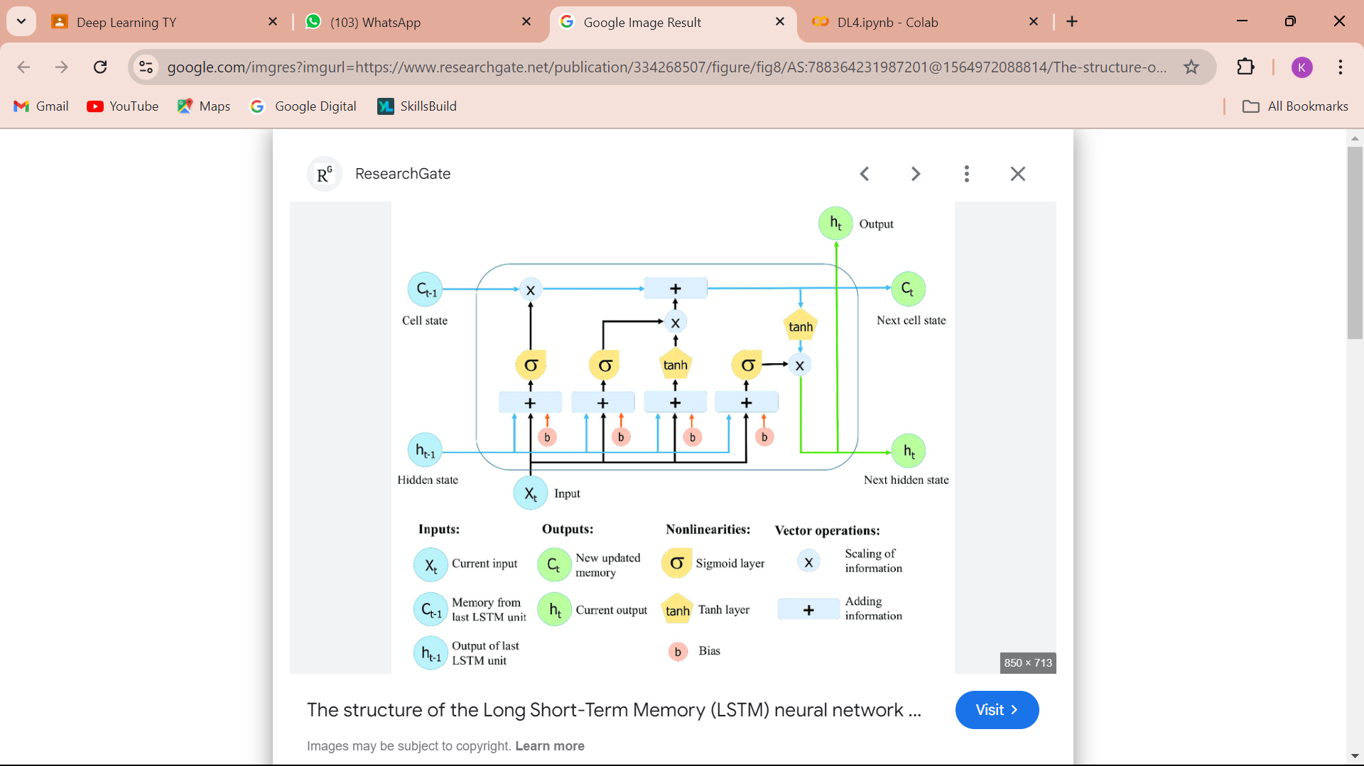

Slide 7
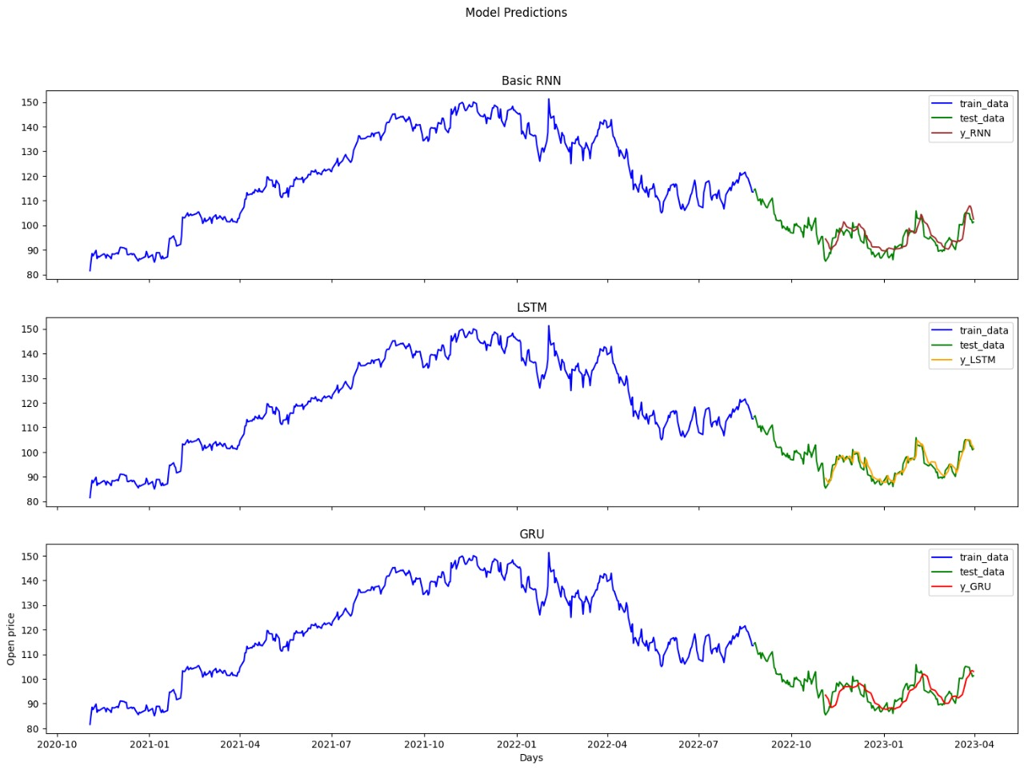
Comparison of Performance of Simple RNN & LSTM & GRU

Slide 8
thank you

